Slide 1
Time Zones and DST
Presented By:
Sarthak
Meghana
Hassan
Sai
Ashika
Dhanush

Slide 2
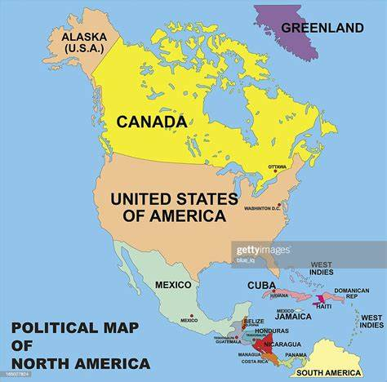
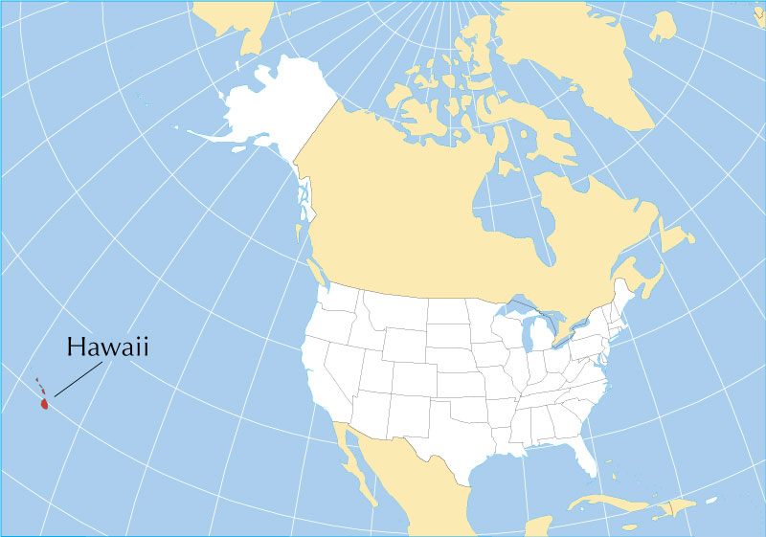
North America -USA

Slide 3
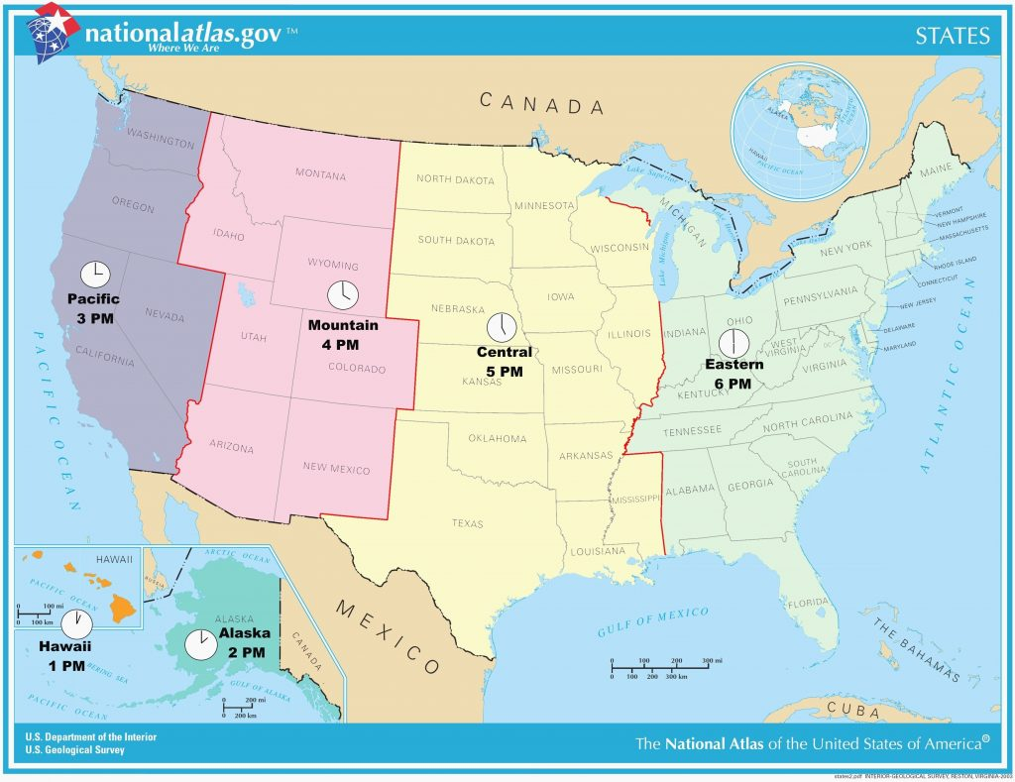
US Time Zone

Slide 4
US Time Zone
EDT – Washington DC (GMT -4)
2:00 am
CDT – Chicago (GMT -5)
1:00 am
MDT – Denver (GMT -6)
12:00 am
MDT – Phoenix (GMT -7)
11:00 pm
PDT – Los Angles (GMT -7)
11:00 pm
ADT – Anchorage (GMT -8)
10:00 pm
HST – Honolulu (GMT -10)
8:00 pm

Slide 5

DST
Daylight
Standard
Time

Slide 6
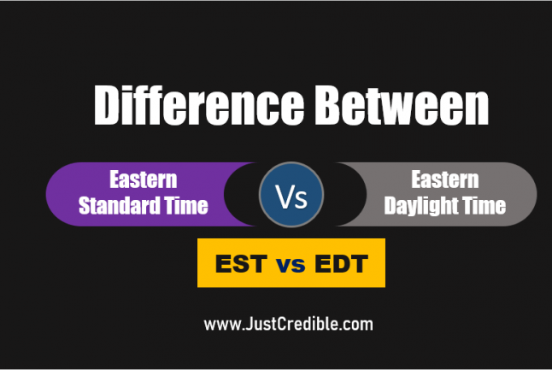
EST and EDT

Slide 7

Seasons
Winter –
Dec - Feb
Spring –
Mar – May
Summer –
Jun - Aug
Fall –
Sep - Nov

Slide 8
Any Questions?

Slide 9

Thank You

